Slide 1
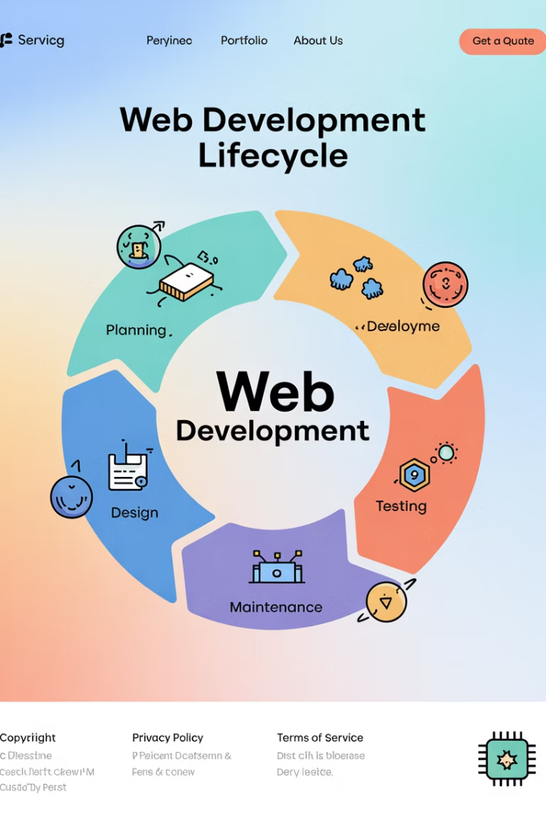
Web Development Life Cycle (WDLC)
The Web Development Life Cycle (WDLC) is a structured process that guides teams through planning, analysis, designing, creating, testing, and maintaining web applications. By following well-defined phases, you can ensure that projects meet requirements, stay on schedule, and deliver high quality.
This presentation will walk you through each phase of the WDLC, providing examples and key activities to help you implement this framework in your own projects.
LW
by Liang Wang

Slide 2




Planning: Setting the Foundation
Define Project Goals
Identify Target Audience
Create Timeline & Budget
Meet with stakeholders to establish business objectives (e.g., "Increase newsletter sign-ups by 25%").
Determine who will use the website and what features they need.
Establish realistic deadlines and financial parameters for the project.
For example, a local bakery might need a website to showcase products and take online orders. During planning, you would determine they need a homepage, product gallery, shopping cart, and contact form, with a timeline of 4 weeks and a budget of $5,000.

Slide 3
Requirement Analysis: Understanding Needs
Functional Requirements
Non-Functional Requirements
Documentation
User registration
Produce a comprehensive Requirements Specification document that serves as a reference throughout the project lifecycle.
Order history
Page load under 3 seconds
Payment gateway integration
GDPR compliance
Search functionality
Browser compatibility
Mobile responsiveness
Write user stories (e.g., "As a customer, I want to search for sourdough loaves so I can order online.").

Slide 4








Design: Blueprinting Your Solution
Visual Design
Color schemes, typography, brand elements
Information Architecture
Navigation flow and content organization
Wireframes & Prototypes
Layout sketches and interactive mockups
Technical Design
Database schema, API endpoints, technology stack
For a bakery website, this phase would include sketching the homepage with a banner, featured products grid, and footer with social links. You'd also define database tables for Users, Products, Orders, and OrderItems to support the site's functionality.

Slide 5

Development: Building the Application
Environment Setup
Configure version control repositories, development frameworks, and coding standards to ensure consistency across the team.
Front-End Implementation
Build the user interface using HTML5, CSS3, and JavaScript frameworks like React, focusing on responsive design and accessibility.
Back-End Development
Create server-side logic, databases, and APIs using technologies like Node.js/Express or .NET to handle data processing and business logic.
Integration
Connect front-end and back-end components, third-party services, and ensure all parts work together seamlessly.

Slide 6










Testing: Ensuring Quality
Integration Testing
Unit Testing
Ensure components work together properly
Verify individual components function correctly
Usability Testing
Gather feedback from real users
Security Testing
Scan for vulnerabilities and weaknesses
Performance Testing
Verify speed and responsiveness under load
For the bakery website, you might write Jest tests for React components (e.g., testing that the "Add to Cart" button adds the correct item) and use Postman to verify API endpoints return the expected JSON responses.

Slide 7
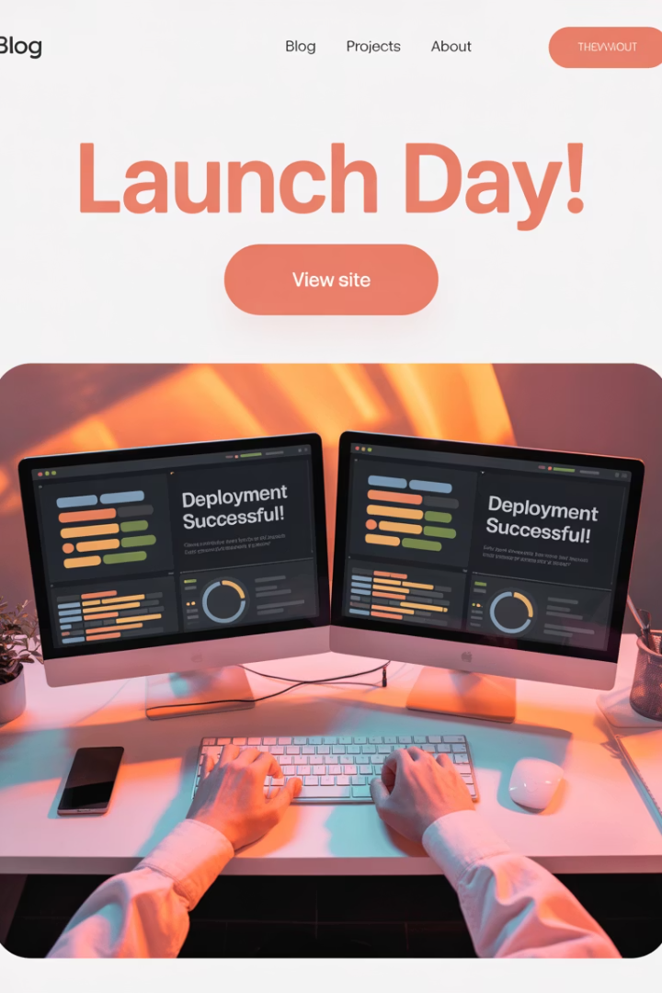




Deployment: Going Live
Server Configuration
Set up hosting environment
CI/CD Pipeline
Automate build and deployment
Security Setup
Configure SSL certificates
Final Verification
Perform smoke tests
For the bakery website example, you might deploy the front-end on Netlify and the back-end on AWS Elastic Beanstalk, configuring automatic SSL certificates to ensure secure HTTPS connections for customers making purchases.

Slide 8
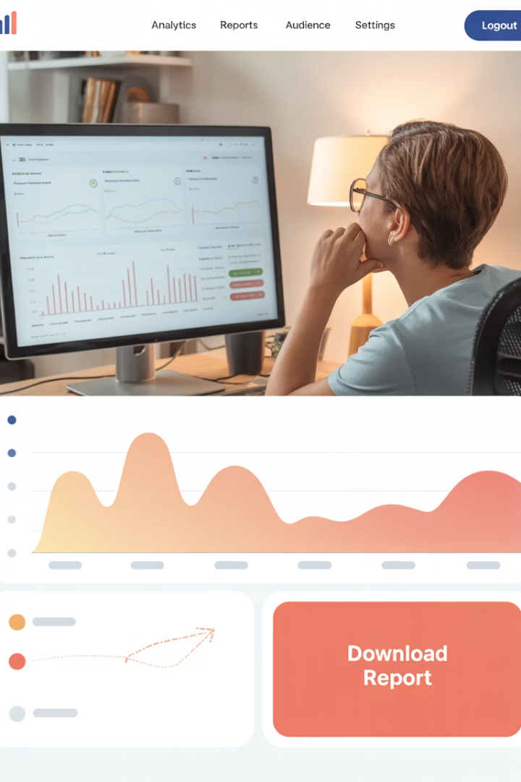
Maintenance & Iteration: Continuous Improvement
Monitoring
User Feedback
Track website performance, uptime, and user behavior using tools like Google Analytics and uptime monitors to identify potential issues before they affect users.
Collect and analyze customer feedback and support tickets to understand pain points and opportunities for enhancement.
Regular Updates
Schedule routine maintenance for security patches, dependency updates, and new feature implementations based on business needs and user requests.
After launching the bakery website, you might notice customers requesting a "pick-up time" selector feature. This enhancement would be planned for the next development sprint as part of the ongoing maintenance process.

Slide 9
The Complete WDLC Process
Planning
Define goals, audience, timeline, and budget
Requirement Analysis
Document functional and non-functional needs
Design
Create visual and technical blueprints
Development
Build front-end and back-end components
Testing
Verify functionality, usability, and security
Deployment
Release to production environment
Maintenance
Monitor, update, and enhance
By following these WDLC phases in sequence, you create a repeatable, transparent process that maximizes quality and stakeholder satisfaction. Each phase builds on the previous one, helping teams manage complexity and adapt to changing needs throughout the project lifecycle.

Slide 10
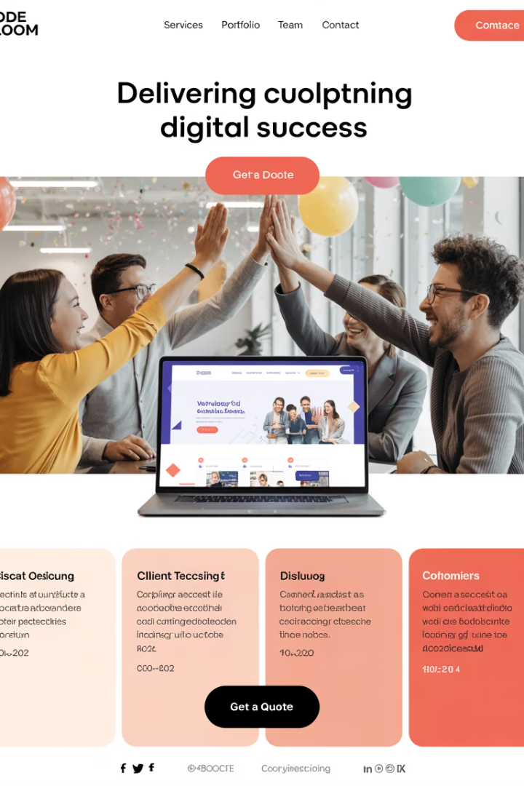




Key Takeaways & Best Practices
Communication is Critical
Document Everything
Embrace Iteration
Thorough documentation at each stage creates accountability and provides valuable reference for current and future team members.
The WDLC is not strictly linear—be prepared to revisit earlier phases as new information emerges during development.
Maintain regular stakeholder updates throughout all phases to ensure alignment and manage expectations.
User-Centered Approach
Keep end users at the center of every decision to ensure the final product truly meets their needs and expectations.
Implementing the Web Development Life Cycle effectively requires discipline and commitment from the entire team. By following this structured approach, you'll deliver higher quality web applications that satisfy both business objectives and user needs.

